Slide 1
Lesson 5: Spring Boot Techniques
5.1 Setting Application Properties at the Command Line
5.2 Specifying which Properties File to Use
5.3 Defining YAML Properties Files
5.4 Using Spring Profiles
5.5 Using Spring Boot Actuator

Slide 2
Lesson 5: Spring Boot Techniques
5.1 Setting Application Properties at the Command Line

Slide 3
Recap of Application Properties
A Spring Boot application can define properties in an application.properties file:
You can inject properties via @Value annotations:
application.properties
name=John Smith
@Component
public class MyBean1 {
@Value("${name}")
private String name;
…
}
MyBean1.java

Slide 4
Source of External Configuration
Spring Boot lets you define application properties in many places, such as:
Command-line arguments
Environment variable SPRING_APPLICATION_JSON
Operating system environment variables
Application properties outside your JAR
Application properties inside your JAR

Slide 5
Setting Properties at the Command-Line
If you define command-line args that start with --
Spring Boot converts them into application properties
E.g., set the name property via a command-line arg:
Let's see an example in IntelliJ…
--name="Mary Jones"

Slide 6
Lesson 5: Spring Boot Techniques
5.2 Specifying which Properties File to Use

Slide 7
Location of Properties Files
SpringApplication looks in the following places to find properties files (highest priority first):
/config subdirectory of your Java app directory
Your Java app directory
/config package on classpath
Root package on classpath

Slide 8
Specifying a Different Properties File
You can tell Spring to use a different properties file:
Alternatively, you can set the SPRING_CONFIG_NAME environment variable
@SpringBootApplication
public class Application {
private static void demo2(String[] args) {
System.setProperty("spring.config.name", "app2");
ApplicationContext ctx = SpringApplication.run(Application.class, args);
…
name=Bill Jones
app2.properties
Application.java

Slide 9
Specifying a Different Properties File
You can also use a command-line argument to specify which application properties file to use:
This enables you to choose a properties file as part of your overall build process
E.g., in a Jenkins build script
--spring.config.name=app2

Slide 10
Lesson 5: Spring Boot Techniques
5.3 Defining YAML Properties Files

Slide 11
Overview of YAML Files
Spring Boot supports YAML as an alternative format for defining application properties:
YAML is convenient for specifying hierarchical configuration data
contact:
tel: 555-111-2222
email: contact@mydomain.com
web: http://mydomain.com
app3.yml

Slide 12
Using YAML Properties in Beans - Technique 1
Here's one way to use YAML properties in a bean:
@Component
public class MyBean3a {
@Value("${contact.tel}")
private String tel;
@Value("${contact.email}")
private String email;
@Value("${contact.web}")
private String web;
…
}
MyBean3a.java

Slide 13
Using YAML Properties in Beans - Technique 2
Here's another way to use YAML properties in a bean:
You also need this dependency:
@Component
@ConfigurationProperties(prefix="contact")
public class MyBean3b {
private String tel;
private String email;
private String web;
…
// Plus getters and setters - these are essential!
}
MyBean3b.java
<dependency>
<groupId>org.springframework.boot</groupId>
<artifactId>spring-boot-configuration-processor</artifactId>
</dependency>
pom.xml

Slide 14
Lesson 5: Spring Boot Techniques
5.4 Using Spring Profiles

Slide 15
Overview
Spring profiles provide a way to segregate parts of your application configuration
So, configuration is only available in certain environments
For example:
"development" profile
"production" profile

Slide 16
Defining Profile-Specific Components
You can annotate component classes with @Profile:
public interface MyBean4 {}
@Component
@Profile("development")
public class MyBean4Dev implements MyBean4 {
@Override
public String toString() { return "Hello from MyBean4Dev"; }
}
MyBean4Dev.java
@Component
@Profile("production")
public class MyBean4Prod implements MyBean4 {
@Override
public String toString() { return "Hello from MyBean4Prod"; }
}
MyBean4Prod.java

Slide 17
Defining Profile-Specific Properties
You can define profile-specific properties:
apiserver:
address: 192.168.1.100
port: 8080
---
spring:
config:
activate:
on-profile: development
apiserver:
address: 127.0.0.1
---
spring:
config:
activate:
on-profile: production
apiserver:
address: 192.168.1.120
Default values for properties
Properties for "development" profile
Properties for "production" profile
app4.yml

Slide 18
Setting the Active Profile
You must tell Spring what is the active profile
Set the spring.profiles.active property
To set the active profile via application properties:
To set it at the command-line:
spring.profiles.active=development
app4.properties
--spring.profiles.active=production

Slide 19
Lesson 5: Spring Boot Techniques
5.5 Using Spring Boot Actuator

Slide 20
Overview
Spring Boot Actuator is a sub-project of Spring Boot
Includes features to help you monitor and manage your application when it’s pushed to production
You can manage and monitor your application using:
HTTP endpoints
JMX
Remote shell (SSH or Telnet)

Slide 21
Adding Support for Actuator
To enable Actuator, add the following dependency to your POM file:
<dependencies>
<dependency>
<groupId>org.springframework.boot</groupId>
<artifactId>spring-boot-starter-actuator</artifactId>
</dependency>
…
</dependencies>
pom.xml

Slide 22
Enabling Actuator Endpoints
To enable all Actuator endpoints, set this property:
Note: If you don't set this property, only the following Actuator endpoints are enabled by default:
/actuator/health
/actuator/info
application.properties
management.endpoints.web.exposure.include=*

Slide 23
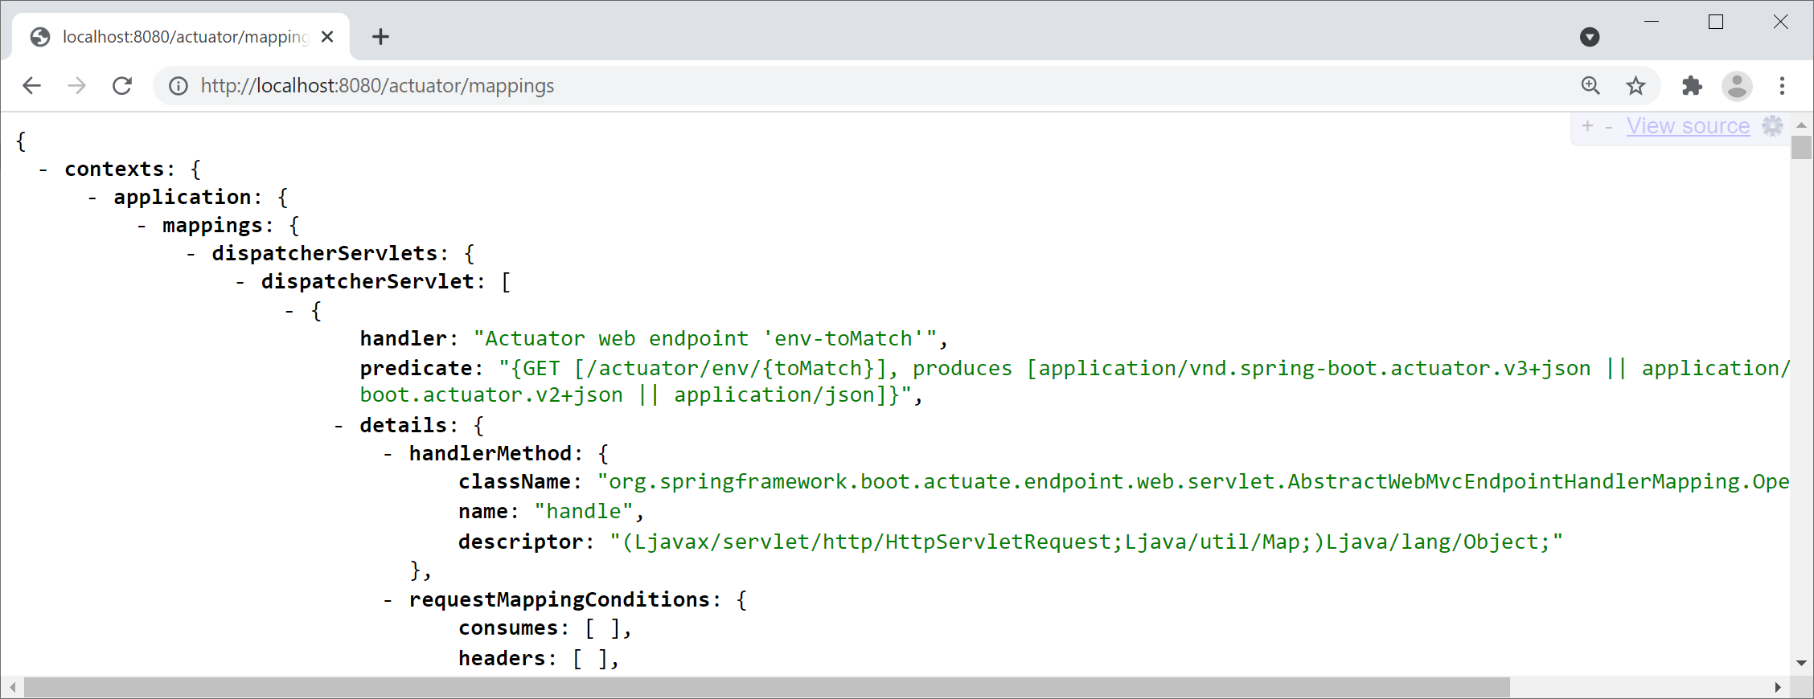
Viewing Mappings
Actuator endpoints enable you to monitor and interact with your application, e.g., actuator/mappings

Slide 24
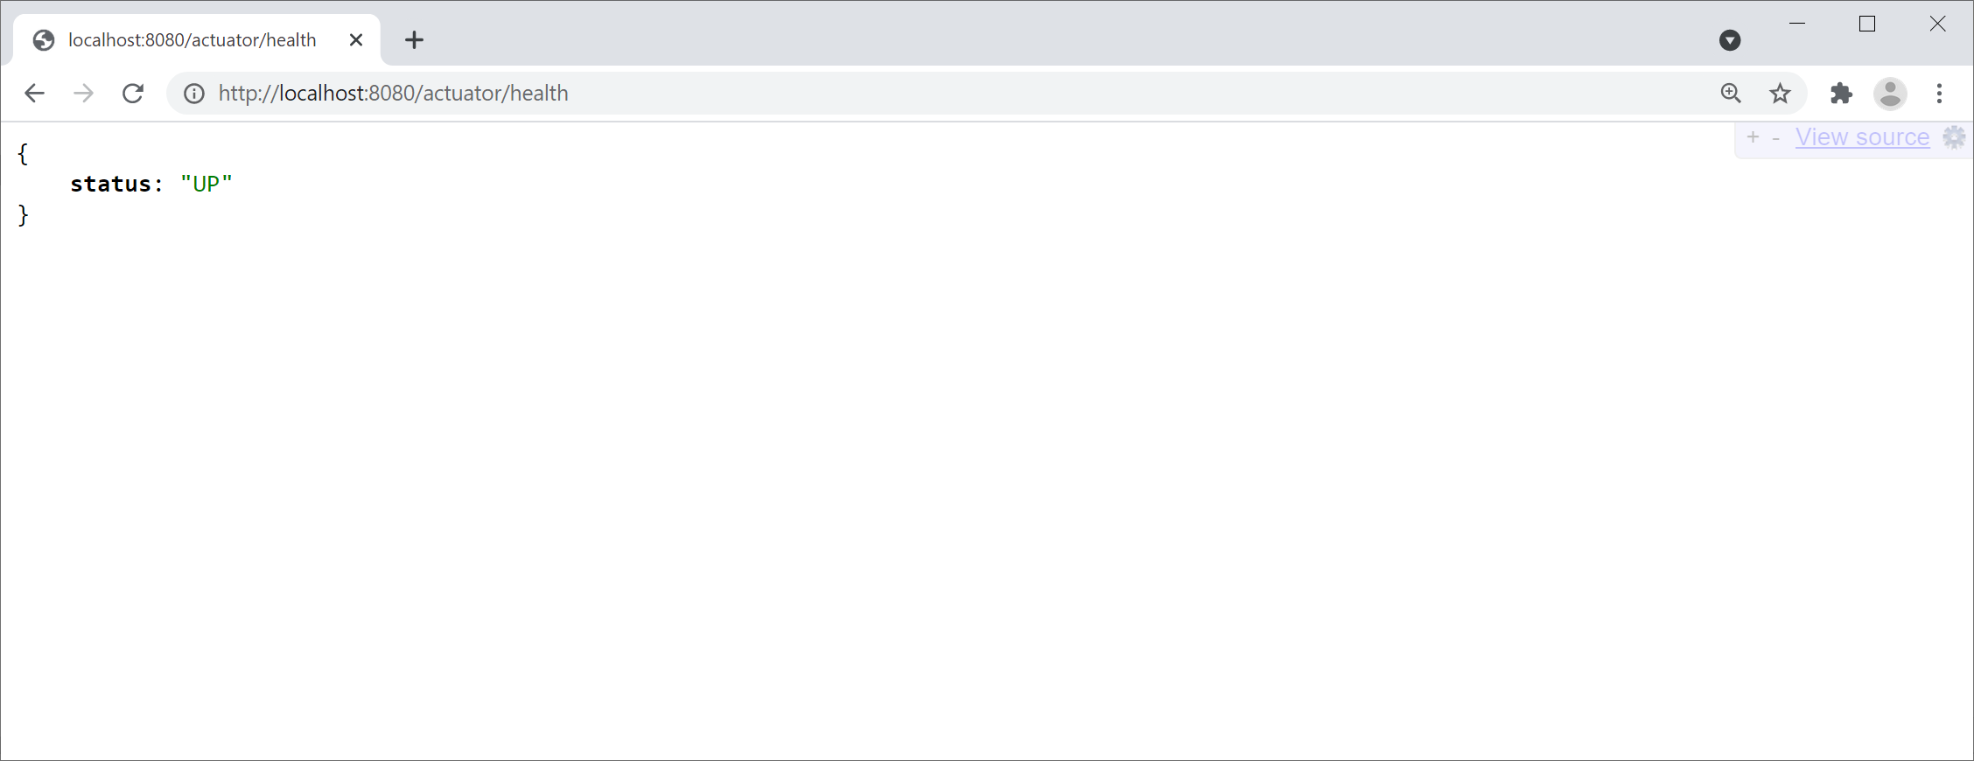
Health Monitoring
The actuator/health endpoint provides basic health information about your application:

Slide 25
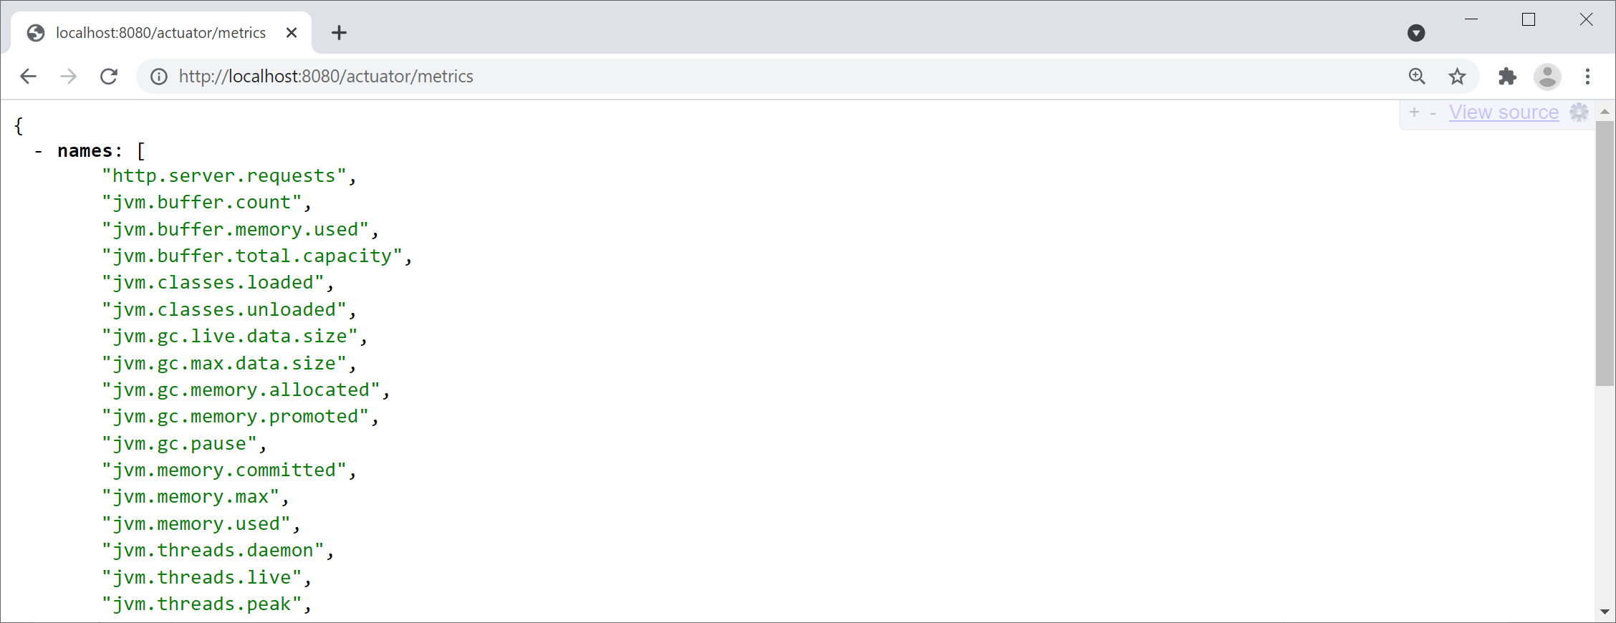
Gathering Metrics
The actuator/metrics endpoint provides metrics that help you identify bottlenecks:

Slide 26
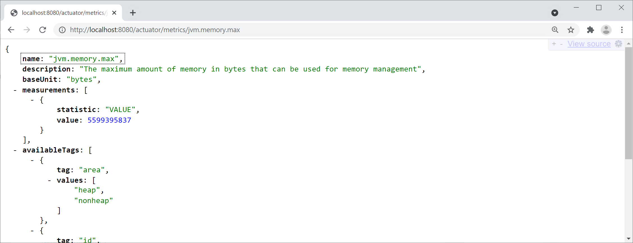
Gathering Metrics
To get detailed metric info, append the metric name, e.g., actuator/metrics/jvm.memory.max

